Slide 1

CRYPTOCURENCY PRICES BY MARKET CAPITALIZATION -SUBBALAKSHMI & -PRAVEENA REDDY

Slide 2

Problem statement
Business problem and use case domain understanding:
the objective of this project is to perform web scraping of the cryptocurrencies based on their market capitalization from coingecko and analyze the data using exploratory data analysis techniques.
The use case for this project is to gain insights into the market trends and behavior of various cryptocurrencies for investors and traders to make informed decisions.

Slide 3
LIBRARIES USED
Beautiful soup
Requests
Pandas
Numpy
Seaborn
Matplotlib.pyplot
Warnings
Plotly.express

Slide 4
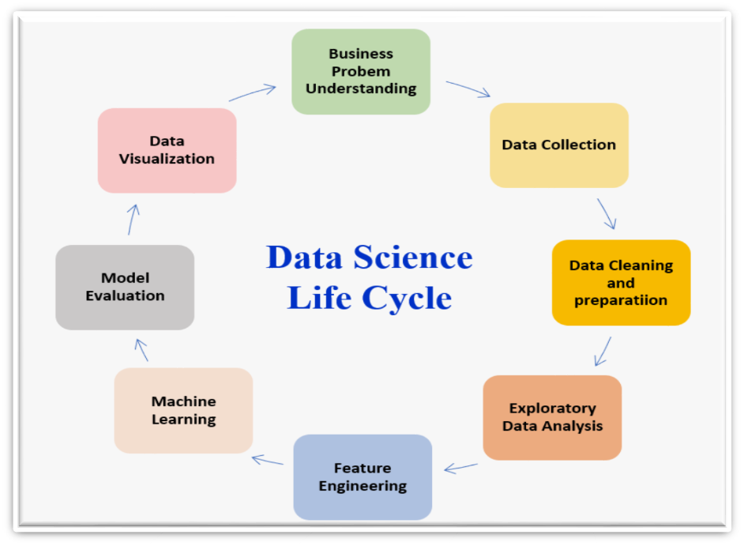

Slide 5
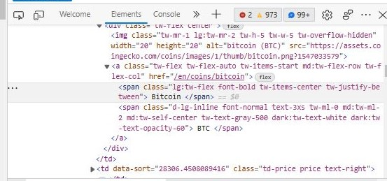

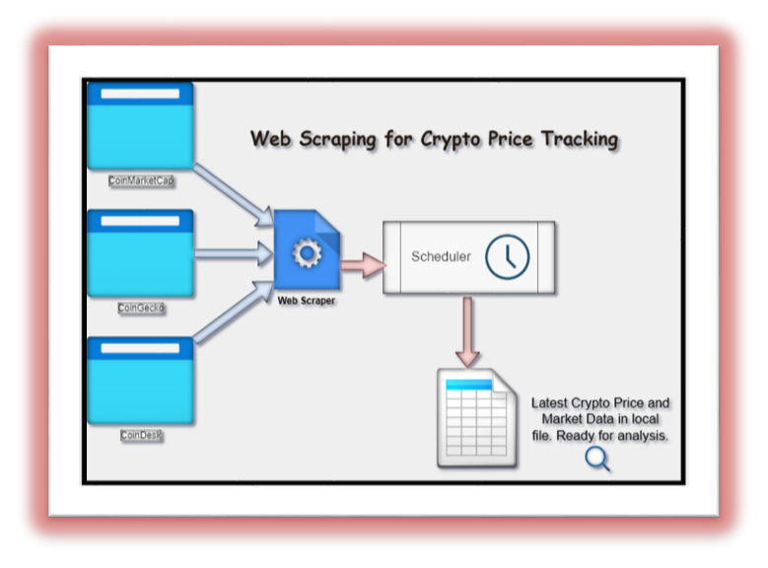
DATA COLLECTION
WEB SITE https://www.coingecko.com
Step1-URL
step2-Fetching
Step3-HTML document
Step4- Extraction
Step5-Desired
Step6-Transfromation
Step7- structured data
Step8-Presentation/Database

Slide 6
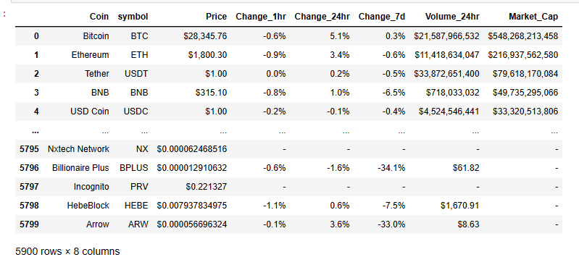
RAW DATA

Slide 7
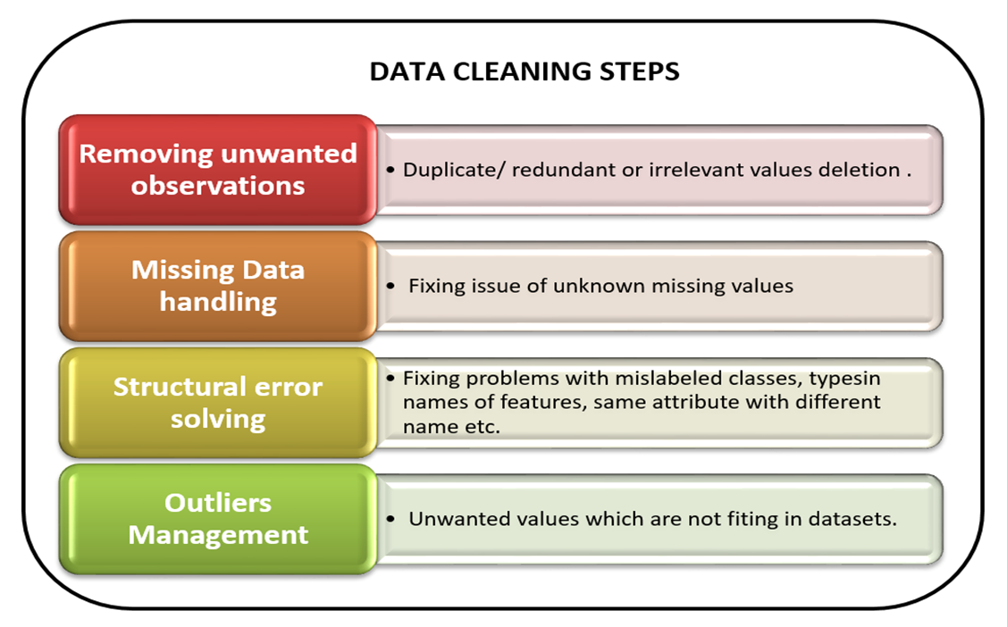

Slide 8
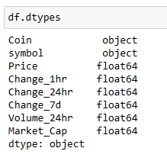
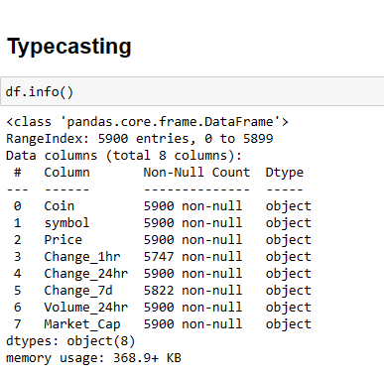
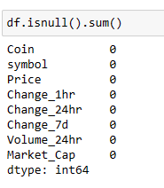
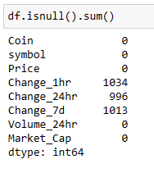
Missing values and type casting

Slide 9
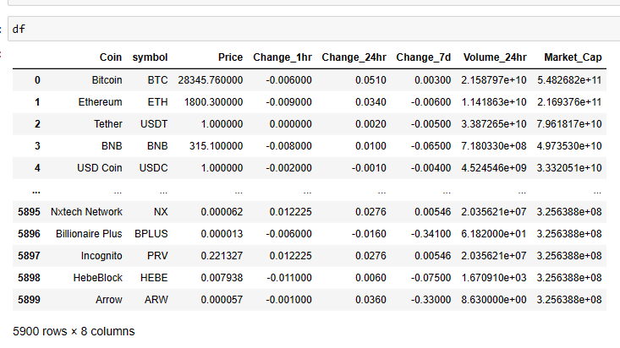
CLEANED DATA

Slide 10
DATA ANALYSIS
steps for analyzing cryptocurrency prices on market cap :
Collect the data: Gather data on the prices and market capitalization of cryptocurrencies from reliable sources, such as Coin Gecko, or Crypto Compare.
Prepare the data: Organize the data into a table or spreadsheet with each row representing a cryptocurrency and columns for the price, market cap, and any other relevant information.
Visualize the data: Use data visualization tools like charts, graphs, and heat maps to help you understand the data and identify patterns and trends
Perform statistical analysis: Use statistical techniques like regression analysis, correlation analysis, and identify relationships between the price and market cap of cryptocurrencies. For example, you may want to analyze the correlation between the price of Bitcoin and the price of other cryptocurrencies, or the relationship between the market cap of a cryptocurrency and its trading volume.
Interpret the results: Finally, analyze the results of your analysis and draw conclusions that can help you make informed decisions about investing in cryptocurrencies. For example, you may discover that cryptocurrencies with top market caps tend to have bottom price volatility, or that there is a strong correlation between the price of Bitcoin and the overall cryptocurrency market.

Slide 11
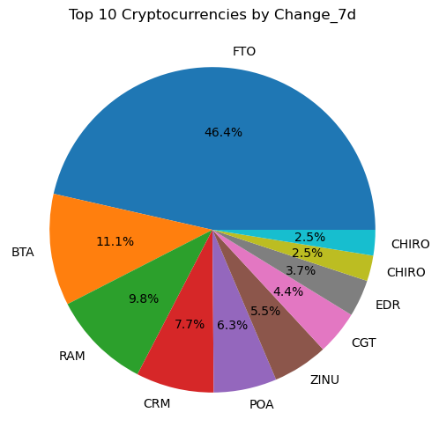
Top 10 Cryptocurrencies by Percentage Change in Value Over 7 Days
To select the top 10 cryptocurrencies based on the 'Change_7d' column, which represents the percentage change in the cryptocurrency's price over the past 7 days.
Overall, the pie chart provides a visual representation of the top 10 cryptocurrencies based on their percentage change in price over the past 7 days. The size of each slice represents the percentage of the total market cap held by that cryptocurrency, and the labels provide an easy way to identify each cryptocurrency.

Slide 12
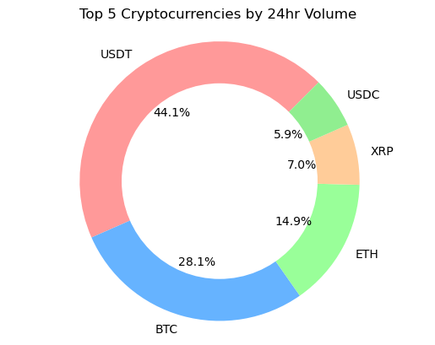
Cryptocurrencies in the Market cap
selects the top 5 cryptocurrencies by 24-hour trading volume and creates a donut chart to present the data. To sort the DataFrame by the 'Volume_24hr' column in descending order, and the select the top 5 cryptocurrencies
Overall, the donut chart provides a visual representation of the top 5 cryptocurrencies by 24-hour trading volume. The size of each slice represents the percentage of the total trading volume held by that cryptocurrency, and the labels provide an easy way to identify each cryptocurrency. The white circle in the center of the chart gives it a donut shape, making it easier to distinguish the different slices.

Slide 13
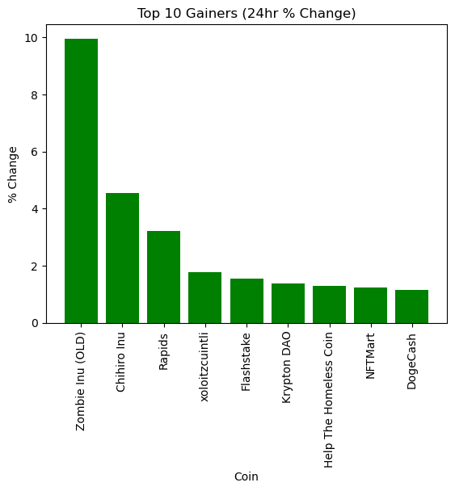
TOP GAINERS
sorts the DataFrame based on the percentage change in price over the past 24 hours and creates a bar chart to present the top 10 gainers. The sort_values() function is used to sort the DataFrame by the 'Change_24hr' column in descending order.
sorts the DataFrame based on the percentage change in price over the past 24 hours and creates a bar chart to present the top 10 gainers. sort the DataFrame by the 'Change_24hr' column in descending order.
Overall, the bar chart provides a visual representation of the top 10 gainers based on the percentage change in price over the past 24 hours. The length of each bar represents the percentage change in price for the corresponding cryptocurrency, and the x-axis labels provide an easy way to identify each cryptocurrency. The chart title and axis labels provide context for the data being presented.

Slide 14
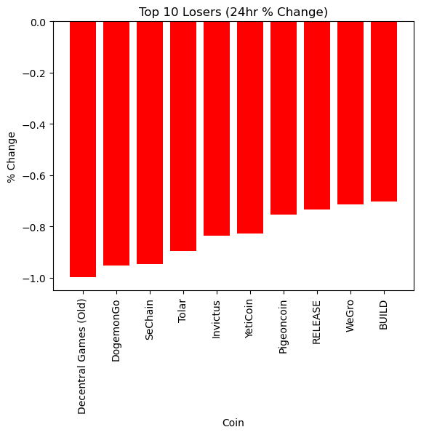
TOP LOSERS
To sorts the DataFrame based on the percentage change in price over the past 24 hours in descending order and creates a bar chart to present the top 10 losers.
Overall, the bar chart provides a visual representation of the top 10 losers based on the percentage change in price over the past 24 hours. The length of each bar represents the percentage change in price for the corresponding cryptocurrency, and the x-axis labels provide an easy way to identify each cryptocurrency. The chart title and axis labels provide context for the data being presented.

Slide 15
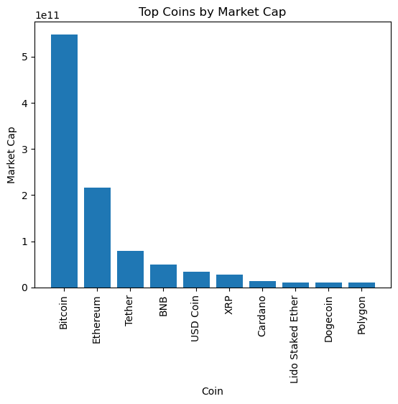
the top 10 coins based on market cap
sorts the dataset by market cap in descending order and extracts the top 10 coins based on market cap. It then creates a bar chart of the top coins' market cap.
Overall, the bar chart provides a visual representation of the top 10 coins based on market cap. The length of each bar represents the market cap for the corresponding coin, and the x-axis labels provide an easy way to identify each coin. The chart title and axis labels provide context for the data being presented.

Slide 16
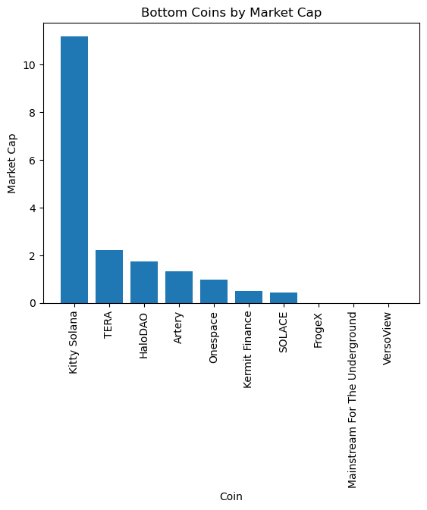
Bottom Coins by Market Cap
creating a bar chart that displays the market capitalization of the bottom 10 coins in a sorted dataset. The x-axis represents the name of each coin, while the y-axis represents the market cap of each coin. The title of the chart is "Bottom Coins by Market Cap". The code is also rotating the x-axis labels by 90 degrees for better readability.
Overall, this chart can be used to quickly compare the market cap of the least valuable coins in a dataset.

Slide 17
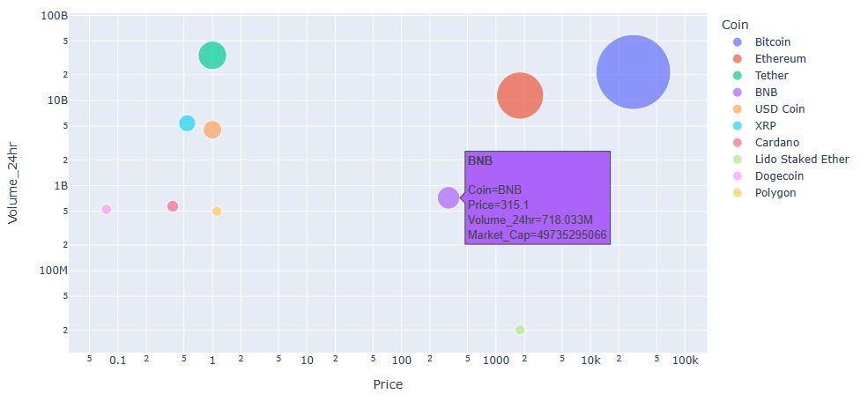
Top 10 Cryptocurrencies by Price and Volume with Market Cap
creates a bubble plot using Plotly Express to visualize the relationship between the price, 24-hour trading volume, and market capitalization of the top 10 cryptocurrencies based on the dataset. The plot uses the Price and Volume_24hr columns as the X and Y axes, respectively, with the size of the bubbles representing the market capitalization of each cryptocurrency.
The plot also uses the color of the bubbles to distinguish between different cryptocurrencies. Additionally, the plot has a hover feature that displays additional information such as the symbol of each cryptocurrency. Finally, the plot is displayed using the fig.show() function

Slide 18
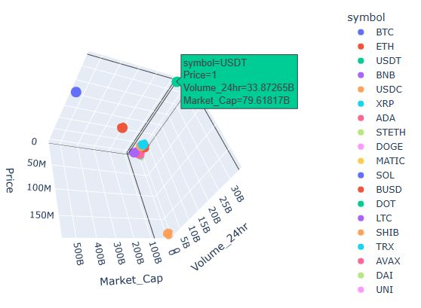
3D Scatter Plot of Cryptocurrency Prices, 24hr Volume, and Market Cap
This is a 3D scatter plot showing the relationship between the price, 24-hour trading volume, and market capitalization of each cryptocurrency in the dataset. Each point represents a different cryptocurrency, with the color of the point indicating which coin it is.
The x-axis shows the price of the cryptocurrency, the y-axis shows the 24-hour trading volume, and the z-axis shows the market capitalization. This type of visualization can help identify any patterns or relationships between these variables, as well as any outliers.

Slide 19
Value of one USD
As of March 24, 2023, 1 US dollar (USD) is equivalent to 82.25 Indian rupees (INR), according to Xe.[1] Another source, Wise, shows that as of a minute ago, 1 USD is equal to 82.2650 INR.[2]Therefore, the value of 1 USD in Indian rupees is approximately 82.25-82.2650 INR.

Slide 20
Prices in USD and INR for 1 Unit as of March 30, 2023
1. Bitcoin (BTC)* Price in USD: $15,634.18*
Price in INR: Rs. 11,363,665.64*
Country of Origin: United States
2. Ethereum (ETH)* Price in USD: $2,748.25*
Price in INR: Rs. 1,22,613.53*
Country of Origin: Switzerland
3. Binance Coin (BNB)* Price in USD: $490.55*
Price in INR: Rs. 33,358.76*
Country of Origin: Cayman Islands
4. USD Coin (USDC) Price in USD: $1.00
Price in INR: Rs. 76.63
Country of Origin: United States
5. Solana (SOL) Price in USD: $464.27
Price in INR: Rs. 9,456.34
Country of Origin: United States
6. Ripple (XRP) Price in USD: $0.75 Price in INR: Rs. 59.84 Country of Origin: United States
7. Terra (LUNA) Price in USD: $33.67 Price in INR: Rs. 4,635.57 Country of Origin: South Korea
8. Polkadot (DOT) Price in USD: $32.76 Price in INR: Rs. 1,871.64 Country of Origin: Switzerland

Slide 21

Websites for buying cryptocurrency

Slide 22
Challenges Faced
Website structure changes: Cryptocurrency websites can undergo frequent updates and redesigns, leading to changes in the website structure. This can cause issues with the web scraping code, leading to errors or incomplete data.
IP blocking: Websites may block IP addresses that frequently access their data. This can be a challenge for web scraping, as it can prevent the scraper from accessing the necessary information.
Data quality: Cryptocurrency data can be volatile and change rapidly, which can lead to inconsistencies or inaccuracies in the scraped data.
Captchas and other security measures: Websites may implement security measures, such as captchas, to prevent web scraping. This can make it difficult to automate the scraping process and may require additional resources to overcome.

Slide 23
Conclusion
The cryptocurrency or digital currency is gaining popularity at present.
The use of the currency will result in making society better because transaction process in this system is more efficient and secure.
This will help in reducing the errors, frauds and cheating taking place in the transaction and paperwork.
The records of every transaction is available in the block and making changes or tempering of records is impossible
This will also have a right impact on the economy of the country.
The establishment of specific rules and guidelines by the government will aid in reducing the limitation of this wonderful technology , this will enable to become more eminent and succeful in the world in the coming future.

Slide 24


